Slide 1

Markdown, Rmarkdown, and knitr
STA 4143 Data Mining
Notes:
Markdown is a really useful language for creating documents without having to deal with a lot of the overhead and complications of using standard markup languages. Markdown is a simplified markup language , and the purpose is to allow you to focus on just writing your content and not have to worry about things like html tags and things like that. In that sense Markdown is very simple and we’ll use it a lot here. All of the labs for the course are written in Markdown and some lecture notes for my R class are written in Markdown. And a nice thing about Markdown is that it's very easy to integrate it with R code, and other programming languages. So, in this lecture I'm just going to talk about the very basics of Markdown. Even, beyond the basics actually you’ll see there's not a whole lot and that's what makes Markdown so nice. I plan on giving you a few pointers and point you to where you can go to learn about more. So,

Slide 2
What is Markdown?
"Markdown is a text-to-HTML conversion tool for web writers. Markdown allows you to write using an easy-to-read, easy-to-write plain text format, then convert it to structurally valid XHTML (or HTML)."
- John Gruber, creator of Markdown
Notes:
John Gruber, the creator of Markdown, wanted people to be able to focus on writing their content, and not other kind of aspects. Markdown is a text to HTML conversion tool for web writers. Markdown allows you to write easy, using an easy to use, easy to read, easy to write, plain text format and then convert to structurally valid XHTML.

Slide 3
What is Markdown?
Created by John Gruber and Aaron Swartz
A simplified version of "markup" languages
Allows one to focus on writing as opposed to formatting
Simple/minimal intuitive formatting elements
Easily converted to valid HTML (and other formats) using existing tools
Complete information is available at http://daringfireball.net/projects/markdown/
Some background information at http://daringfireball.net/2004/03/dive_into_markdown
Notes:
So, first of all, what is markdown? Like I mentioned before, markdown is a simple kind of markup language, It’s a play on words markup language. If you're experienced with languages like HTML or LaTeX, or XML, or some of these other things. you know, one of the things that you notice that you spend a lot of time thinking about the formatting or everything else except the actual content that you're trying to produce. And so the basic philosophy behind markdown is to create a language that allows writers to write basically and not code. Markdown it looks very different from other types of markup languages like XML or HTML or LATEX. Instead of complex patterns it has some very simple, very minimal, kind of intuitive formatting elements so you can emphasize text or create sections and lists. All the kinds of things that you would typically need in a basic document but not the very fancy things that you might have in like MS Word or something. But one of advantages of markdown is that it, you can insert kind of arbitrary HTML elements. So if you are familiar with HTML and you want something that's specific or particular, and there isn't a basic markdown formatting element for it, you can just put some HTML in, in the worst-case scenario. So one of the nice things about markdown is, it's easily converted into HTML. There are tool chains out there that'll take markdown, and in fact convert it into many different formats, HTML just being one of them. So you can let a lot of information at the website of, of John Gruber, where he has a lot of documentation for markdown, and a little bit of background on kind of how this project evolved. So, that was markdown.

Slide 4
Markdown Syntax
Italics
Bold
*This text will appear italicized!*
This text will appear italicized!
**This text will appear bold!**
This text will appear bold!
Notes:
The basic syntax for Markdown is fairly simple. The most straightforward thing to do is format text. For instance, to emphasize text with italics using the asterisks here and then the text will be italicized. You can do things like create bold face with the, with the double asterisk and the text will appear bold.

Slide 5
Markdown Syntax
Headings
## This is a secondary heading
### This is a tertiary heading
This is a secondary heading
This is a tertiary heading
Notes:
You can create headings. There are different sizes, so if you're familiar with HTML you can think of this as H1, H2, H3. So the two hashes, this is a secondary heading. The three hashes is a tertiary heading. And then a single hash, which I didn't put here is a, is like a main heading, a primary heading. And so you can see that there are different sizes here.

Slide 6
Markdown Syntax
Unordered Lists
Ordered Lists
- first item in list
- second item in list
- third item in list
first item in list
second item in list
third item in list
1. first item in list
2. second item in list
3. third item in list
first item in list
second item in list
third item in list
Notes:
You can create very simple unordered lists by putting a little indicator there, like a hyphen or an asterisk. It doesn't really matter what the character is that you use there as long as it's kind of consistent across the list. You can create an ordered list here by just typing one, two, and three. And the truth is actually, although it's not immediately clear here the numbering doesn't have to actually be in order. As long as you use a number as the kind of character that indents the Markdown will render an ordered list. And so, if you decide that oh, you know, you want to stick something in between one and two, you don't have to renumber every element on the list. You can just stick another item there under the first item. And it could be another one, or it could be four, it could be any number, the numbers don't have to be in order, but when you process the document Markdown will automatically order the list in the right way.

Slide 7
Markdown Syntax
Links
Advanced Linking
[UTSA Mgmt Sci & Stats](https://business.utsa.edu/management-science-statistics/)
[Download R](http://www.r-project.org/)
[RStudio](http://www.rstudio.com/)
[SAS](http://www.sas.com/)
UTSA Mgmt Sci & Stat
Download R
Rstudio
SAS
I spend so much time reading [R bloggers][1] and [Simply Statistics][2]!
[1]: http://www.r-bloggers.com/ "R bloggers"
[2]: http://simplystatistics.org/ "Simply Statistics"
I spend so much time reading R bloggers and Simply Statistics!
Notes:
You can of course put links into a document, this is very convenient if you're creating web documents. And there are two ways to create links. The first way I've got here puts the text in square brackets, and then immediately following that puts the URL in parenthesis. So, here I can see UTSA Mgmt Sci & Stats. And and the URL is right next to it, and then Download R with the R website right next to that. And so and then it'll be formatted in an HTML document in the usual way. The text will be highlighted, and underlined.
The other way to create links in a Markdown document is to put the text in square brackets. And right next to it in another set of square brackets put a number which is going to be like an identifier for that link. And then later on, perhaps at the bottom of the document you can put the actual URL for the link you want. So, number one here is for R bloggers and at the bottom of the document I might put a number one and then the R bloggers URL. And then the second link here is for Simply Statistics, so for number two I put the Simply Statistics URL. The basic idea with this type of linking is that it makes the text in your document a little bit cleaner and easier to read. Especially if you have very long URL's. And you, and you don't necessarily want to put all these really long URL's in the document so it makes it hard to read. This makes it a little bit easier to read, while your editing the document and puts all the links down at the bottom.

Slide 8
Markdown Syntax
Newlines
Newlines require a double space after the end of a line.
First line
Second line
First line Second line
First line
Second line
First line
Second line
Notes:
Lastly new lines can be created in the text document by just putting a double space at the end of a line. So I just do first line, second line like this with just, with no space after the first line. All the lines will run together like that. But if I put two spaces after the first line then you'll get a kind of a new line put in between. So just the, that's going to be just an easy gotcha, that can be the people who newly come into Markdown will often discover.

Slide 9
Markdown Resources
The Offical Markdown Documentation
Github's Markdown Guide
Markdown Cheatsheet
Notes:
So that's just a really, really quick overview of Markdown. Here's some basic resources on Mark down. The the official Markdown documentation on John Grubers website. It’s relatively short and very easy to read, it's very. You'll be able to learn it within minutes. You already know most of it just by looking at this lecture. And then, Github has its own kind of Markdown flavor, with a few kind of enhancements. So if you're going to be using Github and documenting things in Github it might be useful to check out their Markdown guide and cheatsheet.
STOP

Slide 10
What is R Markdown?
R markdown is the integration of R code with markdown
Allows one to create documents containing "live" R code
R code is evaluated as part of the processing of the markdown
Results from R code are inserted into markdown document
A core tool in literate statistical programming
Notes:
This lecture's going to be about R markdown. It's going to be a very short and just description of what this is, because we talked about it in a little bit more detail when I talk about reproducible research. So the basic idea behind R markdown is that you want to have R code integrated with a simple language that can be used to kind of create documents. And so the coupling is going to be the R language with the markdown language.
So, that was markdown. What is R markdown? So R markdown is basically the coupling of R code in a markdown document. So, the idea is that if you want to embed R code, in a document that's written in markdown, you use R markdown. And the, the basic idea is that this, it's going to look a lot like a standard markdown document. But there's going to be R code sprinkled in, in, in what are called code chunks. And the code chunks'll be denoted by a special formatting tags, which I'll show you in a little, in a minute. So when you integrate R code with markdown that's an R markdown document, typically has the r m d extension. And so the nice thing about using R markdown is it allows you to insert essentially live R code into a markdown document. So when you process the markdown document to create your HTML or your PDF format, you can evaluate the r code in as part of the processing for markdown. And so, so you know that the code in the document if you're trying to demonstrate a tool, or you're trying, you know maybe show some data or whatever it would be. You know, that the code works in the document because in order for a document to be produced in the first place the code had to be executed and evaluated and run. And so everything in the document, any code that you see in a document, you know will work. Because it had to work to create the document. So that's one nice thing about being able to embed live R code in a document is that you can ensure a, a, some, a certain level of validity of the R code. So the basic idea is the, you know, you evaluate R code it, the, the results of the R code is, is inserted into the markdown document. And mark, R markdown is a core tool in what's known as literate statistical programming. And we'll talk about that a little, much more when we talk about reproducible research. But for now, it's important just to think of R markdown as a way to put R code in a document.

Slide 11
What is R Markdown?
R markdown can be converted to standard markdown using the knitr package in R
Markdown can be converted to HTML using the markdown package in R
Any basic text editor can be used to create a markdown document; no special editing tools needed
The R markdown » markdown » HTML work flow can be easily managed using R Studio (but not required)
Some of my slides were written in R markdown and converted to slides using the slidify package
Notes:
So you can evaluate R markdown documents using the knitr package in R. So the knitr has a, knitr essentially reads an R markdown file, evaluates all the R code in it, it kind of sticks in the results of the R code, and then writes out a Markdown file. Now, that Markdown file can be converted into HTML using the markdown package in R. And so there's a bit, so there's a kind of extra step of the pipeline here. If you were just going to write markdown you could just convert that to HTML right away, but if you're going to write R markdown, then you need to use something like knitr, to kind of evaluate the R code, create the markdown document, and then, bring it to an HTML file.
So the knitr package and the mark down package are, are important for this but any basic text editor can be used to create a markdown document, or R markdown document. That's one of the nice features of this type of markup language is that you don't need any fancy editors to visualize what you're trying write, you can just use any old text editor and it will be fine; you don't need any special editing tools. So the, the basic workflow that you're going to use if you write in R markdown is you write your basic core document as an R markdown file, so it has markdown formatting elements and it has R code in it. Then you convert that into a markdown file using the knitr package, and then you take that markdown file, which is essentially an intermediate file that you're, you're not going to edit this file, and you would take that markdown file, and you convert it to HTML using the markdown package. And then HTML is kind of what you would view in your browser or other viewer. So the, the, now, the key elements of all this is that you don't, you never edit the intermediate or final products, so you never edit the markdown file and you never edit the HTML file. The only file that you're ever going to edit is the R markdown file which has the kind of original R code and original markdown in it. The whole workflow is very easily managed, if you're using something like R Studio. R Studio has knitr and markdown integrated into it and furthermore even has a little web browser built in so you can actually view the final product, so if you're using R Studio, and I'll show a little demonstration of how to do that in R Studio in the lab. There are multiple formats for Rmarkdown, I’ve built slide presentations in R markdown using the slidify package which calls knitr and the markdown packages, to convert them into HTML. So there's a lot of flexibility when you're using a formatting language like R markdown or just markdown because you can convert them to a lot of different other presentation styles.
STOP

Slide 12
Literate Statistical Programming with knitr
STA 4143 Data Mining
Notes:
knitr (part 1)
This lecture's going to be about literate statistical programming. In the lecture about reproducible research, I talked about the basic ideas of what it means for an analysis to be reproducible. But now I'm going to talk about one of the tools that you can use to actually make your analysis reproducible by others, or at least help other peoples to kind of reproduce your analysis. And one of the ways that we talked about making reproducible documents was literate statistical programming concept, or just literate programming.

Slide 13
Problems, Problems
Authors must undertake considerable effort to put data/results on the web
Readers must download data/results individually and piece together which data go with which code sections, etc.
Authors/readers must manually interact with websites
There is no single document to integrate data analysis with textual representations; i.e. data, code, and text are not linked
Notes:
And so the basic idea is authors have to undertake a lot of effort to put data and results on the web. And even when they put that stuff on the web, they, they're all kind of separate. The data’s in place, and the code is in another, and it’s up to us, the reader or consumer of this information, to have to figure out which code goes with which data and how do you how do you escape this code and do you load this first, do you do this first, and so, there can be a lot of confusion even when everything is just available. And so one of the ways you can simply that process is to put the data, and the code together in the same document so to speak so that people can execute the code in the right order, and the data are read at the right times. So you can have a single document that integrates the data analysis with all the human readable text you use to describe was going on. And so you don't have that everything kind of separate pieces but everything's kind of linked together.

Slide 14
Literate Statistical Programming
Original idea comes from Don Knuth
An article is a stream of text and code
Analysis code is divided into text and code “chunks”
Presentation code formats results (tables, figures, etc.)
Article text explains what is going on
Literate programs are weaved to produce human-readable documents and tangled to produce machine-readable documents
Notes:
So, the original idea of how literate program comes from Don Knuth. He was a computer scientist at Stanford and his original system was for writing just regular computer programs and documenting the computer code at the same time as writing the code. So this idea translated to literate statistical program where you wanted to document both your analysis and have the code for your analysis in the same document. Sort of string text and analysis code together by dividing them into text and code chunks. And so the presentation code that formats the tables, or formats figures, and things like that are included along with the article’s text that explains what's going on. So for these literate programs, these two concepts are weaved together into human readable documents, and you can tangle them to produce machine readable documents or just code files.

Slide 15
Literate Statistical Programming
Literate programming is a general concept. We need
A documentation language
A programming language
The original Sweave system developed by Friedrich Leisch used LaTeX and R
knitr supports a variety of documentation languages
Notes:
So, literate programming is a general concept. In order to actually do it, you need a documentation language and a programming language. The original reproducible research tool in R was called the Sweave system that was written by Fritz Leisch. It used LaTeX as the documentation language and R as the programming language. Now, in this lecture I'm going to talk about knitr, which supports a variety of documentation and programming languages beyond LateX and R.

Slide 16
How Do I Make My Work Reproducible?
Decide to do it (ideally from the start)
Keep track of things, perhaps with a version control system to track snapshots/changes
Use software whose operation can be coded
Don’t save output
Save data in non-proprietary formats
Notes:
If you want to make your work reproducible, you have to decide to do it at the start of your analysis. I mean you can decide to do this at any point in your, in your analysis, but it's usually easiest to do it at the very beginning. If you decide at the very end that you want to make your analysis reproducible, then it often is much harder to do and maybe even impossible. And, keep track of things as you go along. You can use a version control system like Git or SVN. I won't talk about that here but if you've heard about that that is a good thing to learn.
It's important to use software, statistical software, whose operation can be coded. That way you can write down the instructions that were used to manipulate or analyze the data. So this generally rules out graphical user interfaces unless those programs will code or keep track of all the clicks that you make on the graphical user interface. Systems like R and other types of packages, since you have to program them explicitly, the code serves as a recipe of sorts for everything that you did to the data. Another key lesson is to not save any output. And by output, I mean mostly any kind of temporary data or transformed data or pre-processed clean data.
Rather than store the clean data set, it might be better just to have the kind of raw data set with the preprocessing code because then you not only can you make the final product, but you can see how you got there. If you just keep the clean data set, and, and then you accidentally lose the preprocessing code, then you don't really have a good record of how you got from start to finish. Rather than keeping the temporary products or even final products, try to keep the original products and the code that got you there. And that will make it easier to understand what you did and how you got to the data that you ended up analyzing.
And try not to save data in non-proprietary formats. These are data formats where the layout of the data set is not publicly known. There are not too many proprietary formats out there any more that I think are commonly used like they were before. For example, some products will store data and because it's just much more efficient in a proprietary format, but that makes it difficult to transfer to another person if that person doesn't have the same exact program. Then they won't be able to read the data. And so using non-proprietary, even compressed textual formats may can be much better at making analysis more reproducible.

Slide 17
Literate Programming
PROS
CONS
Text and code all in one place, logical order
Data, results automatically updated to reflect external changes
Code is live--automatic “regression test” when building a document
Text and code all in one place; can make documents difficult to read, especially if there is a lot of code
Can substantially slow down processing of documents (although there are tools to help)
Notes:
So there are a couple of pros and cons when it comes to the literate programming style, this is not the only tool you can use to make your work reproducible, but literate programming is just one of the tools. And so, some of the pros of that; it forces you to put all the text and the code of your analysis in one place, and it occurs in a logical order. All the data and the results are automatically updated to reflect external changes, so you have this living document, and you make some changes, when you reprocess the document, it will automatically update itself to reflect any changes. So you won't have a situation where numbers will be out of date or things will be mismatched because the code will kind of automatically recalculate everything. Because the code is live in the document, a necessity you have to run the code in order to produce the final document. That's the weeding process.
You get this kind of regression test so to speak, not like linear regression, but regression test to see so if there are any mistakes that you introduced into the analysis. If the code doesn't run then you know you've made, you've made an error, you've introduced a problem so the running of the live code will kind of keep you from introducing new errors into the analysis.
Some of the cons when it comes to literate programming are that of course the text and the code are all in one place so in particular if you have a lot of code or a very complex lengthy analysis then you're like a human readable text is going to be mixed in with all this code and it can make it difficult to edit the document because you have to somehow search through this whole document to figure out where the text is amongst all the code. So that can be a problem for the author. Also, if your analysis is very complicated and you have to re-process this document every time you see a human readable version of it. It can, it can a bit substantially slow down the process by which you build the document.
STOP

Slide 18
What is knitr?
An R package written by Yihui Xie (while he was a grad student at Iowa State)
Available on CRAN
Supports RMarkdown, LaTeX, and HTML as documentation languages
Can export to PDF, HTML
Built right into RStudio for your convenience
Notes:
So what is knitr? So knitr is this tool that can help you make these reproducible documents. Knitr is an R package. It's written by Yihui Xie (eehway seeah) who wrote the package while he was a grad student at Iowa State. It's available on CRAN. If you happen to use the package R Studio it's actually built into R Studio, meaning it’s integrated into the graphical user interface. And so, you don't even have to obtain it separately if you're using R-Studio. It supports a documentation language called RMarkdown. It also supports, LaTeX and HTML. So these are three languages, that are commonly used. And then, it can export to PDF and HTML and you can also export to other formats if using, using other external tools like Pandoc.

Slide 19
Requirements
A recent version of R
A text editor (the one that comes with RStudio is okay)
Some support packages also available on CRAN
Some knowledge of Markdown, LaTeX, or HTML
We will use Markdown here
Notes:
To use knitr you need a recent version of R. You need a text editor, and you can use the one that comes with Rstudio. If you’re not using that any old text editor will do. You need some support packages that are available from CRAN. These will be automatically downloaded if you use the install dot packages function. You need some knowledge of one of the three documentation languages. So, you need to know Markdown, LaTeX or HTML. And I will talk about Markdown here since it's a fairly simple language to understand.

Slide 20
What is Markdown?
A simplified version of “markup” languages
No special editor required
Simple, intuitive formatting elements
Complete information available at http://goo.gl/MUt9i5
Notes:
So, what is Markdown? Well, like I said before, it's a simplified version of common markup languages. LaTeX and HTML could be thought of as markup languages, where you take regular text and you kind of add things to it, like tags and other types of annotation to indicate what you want to do with the text. One problem with markup languages is that they can be kind of difficult to read. All the tags and things that can obscure the actual text. The real purpose of Markdown is to of simplify all that, and make it easy to read just the text and only have a few kind of formatting elements that you need to enter into the document. There's no special editor required, just a standard text editor, like Notepad, you know, whatever you want to use. There are simple, intuitive formatting elements and you can get all of the documentation at this website here.

Slide 21
KNITR YES/NO?
KNITR IS GOOD FOR
KNITR IS NOT GOOD FOR
Manuals
Short/medium-length technical documents
Tutorials
Reports (esp. if generated periodically)
Data preprocessing documents/summaries
Very long research articles
Complex time-consuming computations
Documents that require precise formatting
Notes:
So, what is knitr good for in terms of creating reproducible documents? Well, personally, I think it's good for things like manuals. If you want to instruct someone on how to use a piece of software. Short or medium length technical documents so you're explaining some technical concept. Tutorials, if you want to, again, like a manual, but maybe more extended, a tutorial on some topic. reports, they're especially useful for reports. If you have to, for example, generate a report on some database or some dataset every week. If you're running a study and you have subjects that are constantly being enrolled in the study and then maybe every week you generate a report on it that has summary statistics about the study, Then these kinds of live documents are very useful because you can recalculate all the summary statistics as you generate the document. You don't have to do it by hand and then stick it into a report separately. And then also for data preprocessing. If you're going to preprocess a raw dataset to create a clean dataset, for example, creating a knitr type document that records all of the things that you did to the dataset to make it clean. Maybe you remove some outliers, maybe you fill in some missing data, maybe you transform a variable here and there. All of that can be documented, in this kind of knitr file, you know, where you simultaneously say what you did and then you actually do it in the code.
What is knitr not good for? Well, it's not very good for very long research articles, so if you're writing a very complex, very involved analysis, it can get a little bit confusing to kind of edit this document if there's a lot of code and a lot of text because everything is stored in a single document.
If you have very complex or time-consuming computations then knitr is often not a good format because you have to recompile this document every time you want to look at it. And so if your computations are very slow this will just kind of make everything slow. And furthermore if you want to create a document that requires very precise formatting. So if you have a special layout and the pictures have to go here and the text has to go here or something like that. Knitr is, again, not a super great tool for that because the formatting tends to be very ad hoc.
STOP

Slide 22
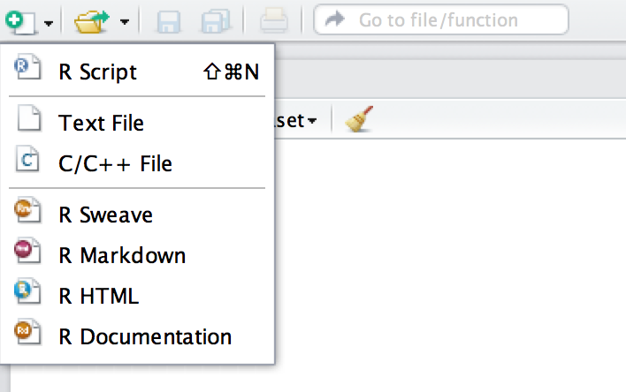
My First knitr Document
Create a new document
Choose an R Markdown Document
Notes:
So how do we create a basic knitr document? So I'm going to talk about this in the context of R studio, because I think it's the easiest way to do it. There are other ways to do this, so this is not really exclusive to R studio but this discussion I'll show you will be in R studio. So if you click on the New Document button on the upper left, you'll see that there are a variety of options. And you can click the R Markdown option to create a new markdown file that'll have your text and codes.

Slide 23
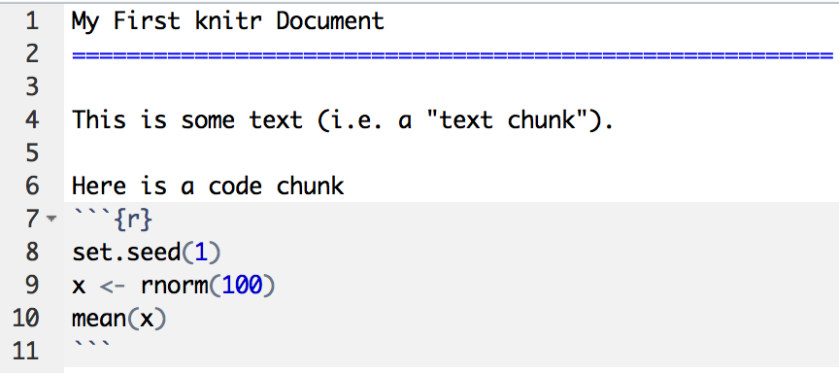
My First knitr Document
Start of code chunk
End of code chunk
Notes:
Here's your basic R markdown document. So R markdown is just markdown with R code embedded in it. You can see that what I have here is a basic symbol that indicates that I'm going to start a code chunk. So when I have the three back ticks, then the curly braces, and an r, and then a close curly brace, that indicates that I'm starting a code chunk. So as you can see I have three lines of R code here. I set a seed, and generates 100 random normal variables. And then I just take the mean. And then I close this code chunk with three back ticks. You know you did it right when the shaded area for code appears. In the text space, I’ve have a title is my first knitr document. And then I said, just a line of text that says, this is some text. And I say, here's a code chunk, and then I start the code chunk.

Slide 24
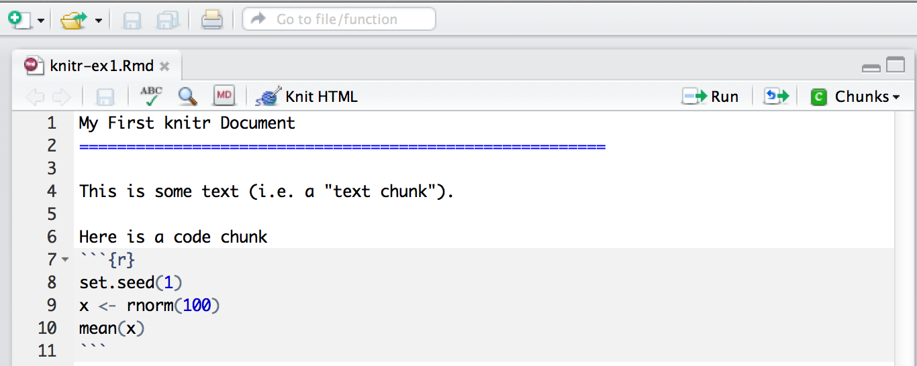
Processing a knitr Document
Push here
Notes:
So in R studio you'll have this document with the code chunks and the text chunks there together. When you’re ready to process the knitr document, and create some human-readable output, you run the R code, by executing these three lines of R code. And then you want embedded the output from that R code in your document. There's only one piece of output, that’s the mean calculation. All this is very easy in R Studio, you can just push the Knit HTML button, and it will automatically run everything for you.

Slide 25
More Complicated Way
library(knitr) setwd(<working directory>)
knit2html(“document.Rmd”)
browseURL(“document.html”)
Notes:
If you're not using Rstudio, the way you can do this is you can load the knitr package with a library function you can make sure your working director is set to wherever the Rmarkdown document is located typically Rmarkdown documents will have a capital Rmd extension. It's not necessary but it's just a good way to identify these types of files. You can use the knit2html function if you want to create a webpage as your output. And you will automatically process the r markdown file and run the r code and put the r code within the file. And then, within r, if you want to open this in your web browser, you can use the browseURL function. the knit2html function will take your r markdown document, create a html file with the same name then, then you can open in your web browser.

Slide 26
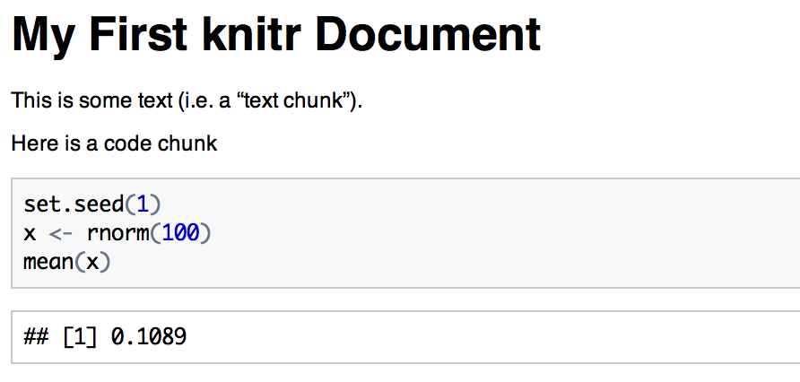
HTML Output
Code input
Numerical output
Notes:
So here's the output that you would get, this is the HTML format output that you would get. You can see there's a title in bold, in large text, there's some regular text. The code is kind of in the shaded box, and then the output from that code is directly below, here you can see here the mean is 0.1089. So that's the output that came from the mean function.

Slide 27
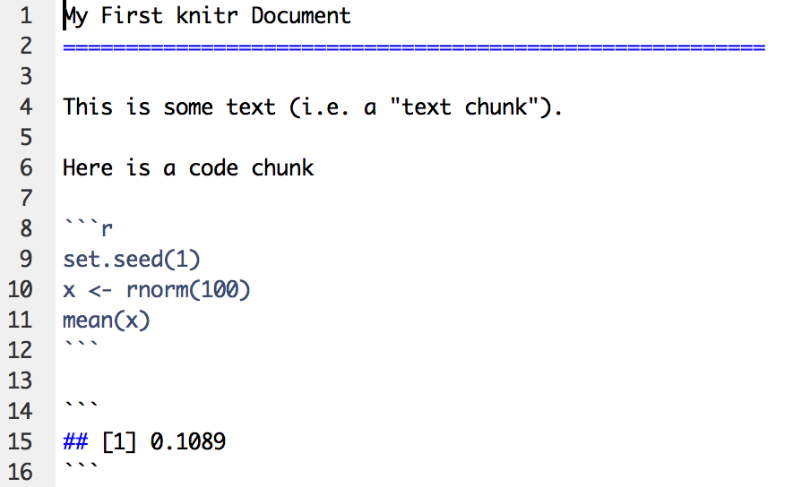
What knitr Produces: Markdown
Markdown Document (generated)
Rmarkdown Document
Markdown Document (generated)
Code is echoed
Result of evaluating R code
Notes:
When you knit, your original RMarkdown document, you see on the left here is processed a regular Markdown document. As you can see that it reproduces the code in the regular markdown document. But you can see that the in the markdown document there's one extra piece, which is that the result of the code which is down here at the bottom. And so the result of evaluating the r code is added to the markdown document after evaluating the r code.

Slide 28
A Few Notes
knitr will fill a new document with filler text; delete it
Code chunks begin with ```{r} and end with ```
All R code goes in between these markers
Code chunks can have names, which is useful when we start making graphics ```{r firstchunk} ## R code goes here ```
By default, code in a code chunk is echoed, as will the results of the computation (if there are results to print)
Notes:
When you create the new knitr document in RStudio, it will populate that document with some kind of generic filler text. So the first thing you probably want to do just delete it, because that's , most likely not going to be relevant to whatever you want to do.
Code chunks begin, with the three back ticks the curly braces with an r. And you end a code chunk with three back ticks. All of your R code will go between these markers. Now you can have more than one code chunk. You can have as many code chunks as you want. So you don't have put all of the R code in within the code chunk. But any R code that you do have goes in a code chunk indicated by three back ticks. You can have names for your code chunks so you can name them after so immediately after the curly brace the r you can put a name it can be anything you want and then you can close it with a curly brace. And then by default the code in a code chunk will be echoed in the output document so just like in the in the HTML document you saw that it echoed the code and then it gave you the result of that code. By default, you will, all the code chunks you'll be able to see in the document, the code that was produced.
STOP

Slide 29
Processing of knitr Documents (what happens under the hood)
You write the RMarkdown document (.Rmd)
knitr produces a Markdown document (.md)
knitr converts the Markdown document into HTML (by default)
.Rmd → .md → .html
You should NOT edit (or save) the .md or .html documents until you are finished
Notes:
So the processing of the knitr document happens in a certain way. First the RMarkdown document is processed and creates a markdown document, then the markdown document is converted to HTML, and then the HTML file is what you view is the final product. Generally speaking, you do not want to edit or mess with any of those secondary documents. You don't want to edit the markdown document or the HTML document because those are automatically generated. If you edit them, and then you reprocess the doc, the original document, all of your changes will be overridden in the HTML file or in the Markdown file. So only edit the RMarkdown file that's been, that contains the original text and the original Rcode.

Slide 30
Another Example
# My First knitr Document
Joey Campbell
## Introduction
This is some text (i.e. a "text chunck"). Here is a code chunk.
Level 1 heading
Level 2 heading
```{r simulation, echo=FALSE}
set.seed(1)
x<-rnorm(100)
mean(x)
```
Do not echo code
Notes:
So here's another example, I've got my first knitr document , my level 1 heading indicated by the single hash, and I've started a section called the introduction, the level 2 heading in, indicated by the two hashes, and say here's some text, here's a code chunk, and I named the code chunk simulation, and notice I added this option echo equals false. That tells knitr that I don't want the code for this code chunk to be echoed in the output document, I just want the result to show.

Slide 31
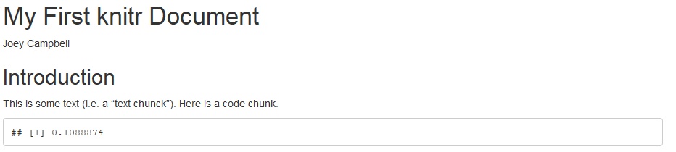
Output
Notes:
So now this is the output document, again, you could see that it looks like the original document that I had in the previous example. But I don't see the code, Ionly see the output, which is the mean.

Slide 32
Hiding Results
# My First knitr Document
Joey Campbell
## Introduction
This is some text (i.e. a "text chunck"). Here is a code chunk but it doesn’t print anything
```{r simulation, echo=FALSE, results=“hide”}
set.seed(1)
x<-rnorm(100)
mean(x)
```
Notes:
You could also hide the results, too, if you wanted too. In this case it doesn't make too much sense, but you could do it by adding the results equals hide option.

Slide 33
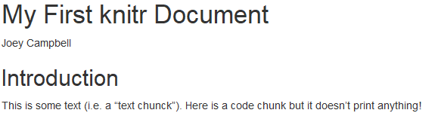
Output
Notes:
And then when you see the output document, you see that all the text is there but there's no code, and there's no results.

Slide 34
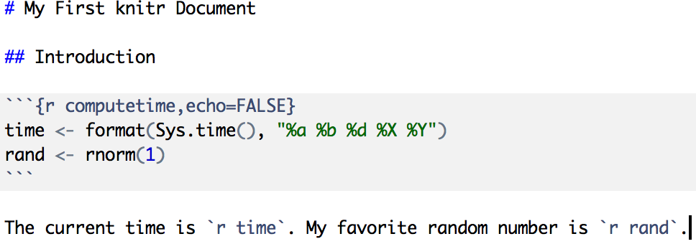
Inline Text Computations
Notes:
One of the nice things about knitr document is that you can write sentences and text. And if you need to fill in a number or a statistic or some sort of computation in the middle of sentence you can just add that directly into a sentence. So for example here I have a code chunk which computes the time and using the Sys.time() function and then I also generate a random number. And so, now I can write a sentence. In that code chunk, I don't echo the codes, I don't want people to see that code, what I want people to see is the sentence immediately afterwards, says the current time is, and then I'll just plug in the current time. And then the next sentence is my favorite random number is, and then I'll just plug in a random number.

Slide 35
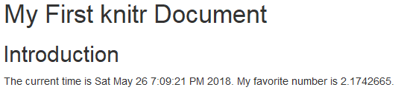
Inline Text Computations
Notes:
So here, you see the output is, the current time is Saturday May 26th and there’s the time and 2018. And you can see my favorite random number is 2.1742665. So that's how you can plug in computed variables, or computed results in the middle, inline with text.

Slide 36
Incorporating Graphics
## Introduction
Let’s first simulate some data.
```{r simulation, echo=TRUE}
x<-rnorm(100);y<-x+rnorm(100,sd=0.5)
```
Here is a scatterplot of the data
```{r scatterplot, fig.height=4}
par(mar=c(5,4,1,1), las=1)
plot(x,y,main=“My Simulated Data”)
```
Adjust figure height
Notes:
Another important aspect of any report probably is going to be some graphics. So if you want to incorporate plots any sort of visualization into your document. So you can easily add this into an Rmarkdown document. In the first code chunk I simulated some data. And in the second code chunk, I make a plot. So I use the par function to set the canvas with the margins. Then I call plot to to generate the plot. And you notice I added an option here which adjusts the figure height. And so actually fig.height equals four which makes a little bit of squished more than usual. So it would a be a rectangular type of plot rather than a square plot.

Slide 37
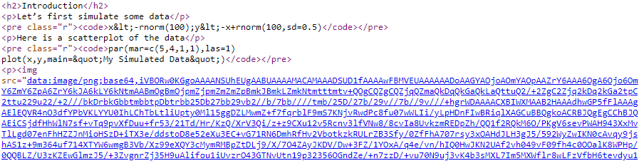
What knitr Produces in HTML
Image is embedded in HTML
Notes:
And so what knitr produces is a little bit interesting. It creates an HTML file through the processing. So if you're familiar HTML at all you can see this is basic HTML. Now, I've cut off a lot of stuff from the top, this is just the body in. And you can see that down here at the bottom, you'll see there's an image tag. But rather than point to an image file, it actually embeds the entire image into the HTML files itself. So you can see this is a Base64 encoded image and so actually this HTML file stands alone, it doesn't depend on an external image file, which is not necessarily the most efficient format but it's actually quit useful because you can take this HTML file, give it to someone else, and they don't have to worry about whether they have, everything's, about whether they have these other files or not because everything's embedded.

Slide 38
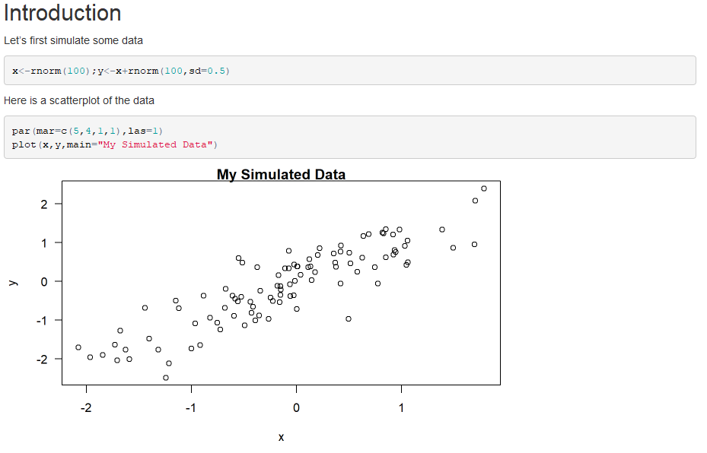
Incorporating Graphics
Notes:
So here's the result as you can see I echoed the Rcode I had the result of the plot. And you see it's kind of this rectangular shape, and that's my scatter plot.

Slide 39
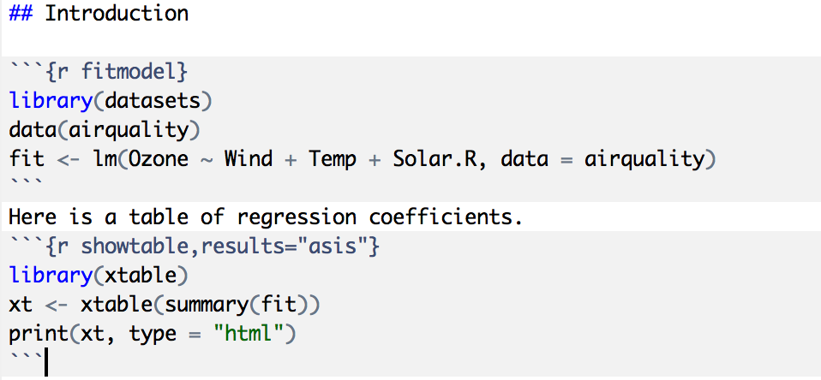
Making Tables with xtable
Notes:
So another handy thing you can do in a knitr document is make a table. And often you want to make a table that summarizes the result of some calculation, like a regression model. So, here I have a code chunk where I load some data. And I fit a regression model to it. Here I'm modelling ozone concentrations, as a function of wind, temperature, and solar radiation. And I want to summarize the output from this Linear Regression model in a prettier format compared to the standard model results products by the summary() function. I use the xtable package, which is available on CRAN. You have to install it separately, it doesn't come with R.
And I'm going to use the xtable function to summarize the fit. And I'm going to use, and I'll print it to HTML.

Slide 40
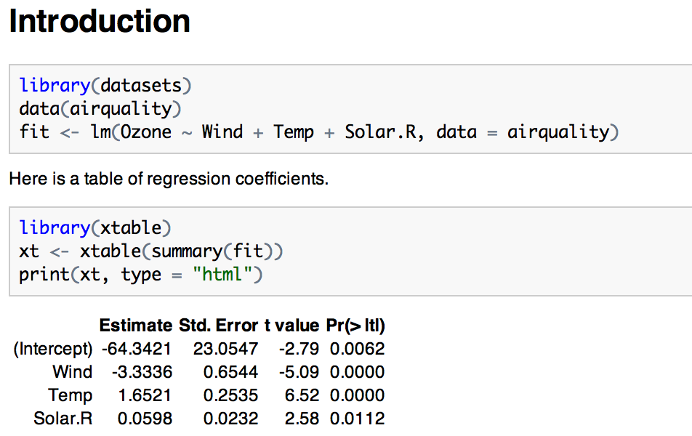
Making Tables with xtable
Notes:
And you can see that in the resulting HTML output after I process it with knitr. I get the code that I ran for the regression model. The code is echoed, and at the very bottom here I can see that I got a table of regression coefficient, standard errors, T values and P values, which is formatted in HTML. And, it’s in a prettier format than the standard text mode.

Slide 41
Setting Global Options
Sometimes we want to set options for every code chunk that are different from the defaults
For example, we may want to suppress all code echoing and results output
We have to write some code to set these global options
Notes:
Sometimes, you want to set options for the entire document. These are called Global options, and apply to every single code chunk. You know, if you decide you never want to echo the code, for example, you could put echo equals false into every single code chunk, that would be a bit of a pain to have to specify every single code chunk, so you could set a global option instead.

Slide 42
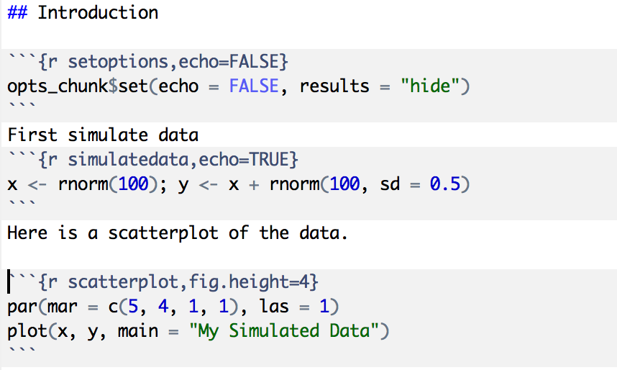
Setting Global Options
Set default to NOT echo code
Override default
Don’t echo code here
Notes:
The way you can do that is you can create a separate code chunk in the, in the very beginning of the document. Here I've called the chunk ‘set options’. And there's a special object you can modify called opts underscore chunk, which has a function built into it called set. And when you call that set function, you can set the global options. So here I’ve set echo equals to false and I've set the results equal to hide. Now, by default, every code chunk in this document will not echo the code and will hide the results.
So I've got some more code chunks here, I simulate some data in the first and make a plot in the second. Now in the first code chunk, I override the default for the, for the echo so I want to echo equals true. And then for the second, code chunk, I don't want to echo the plotting code. And so I, I let the default occur.

Slide 43
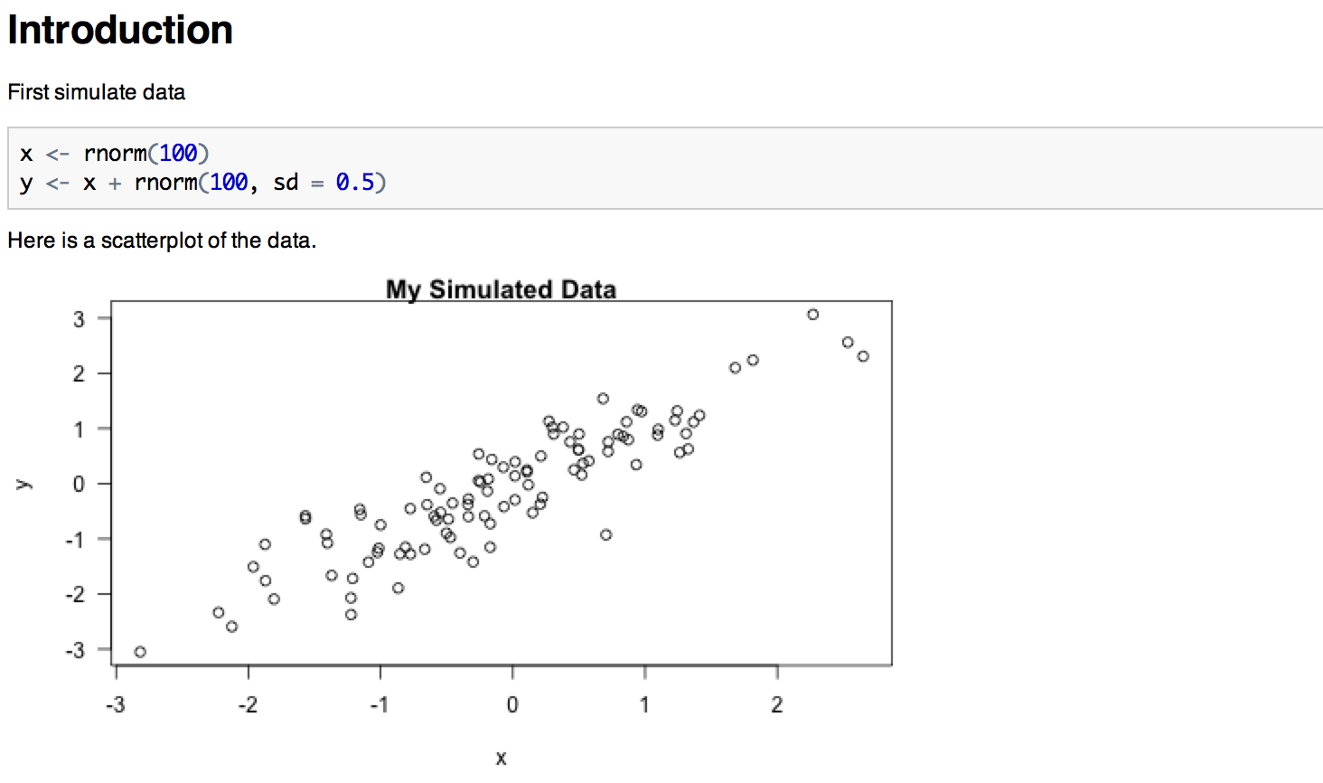
Setting Global Options
Notes:
So here the code that generates the data is echoed but the code that creates the plot is not echoed.

Slide 44
Some Common Options
Output
results: “asis”, “hide”
echo: TRUE, FALSE
Figures
fig.height: numeric
fig.width: numeric
Notes:
So, some of the common options that are, that are good to remember, of course you can always go back to the documentation on the knitr website, results can be specified as either hide or asis. Asis means don't, don't postprocess the results, just show the, kind of the, the raw results from whatever the output is.
Echo can be true or false. So if you want to echo the code or not. For figures usually you might want to modify the height and the width to be a specific type of size of fig.height and fig.width are common options to set there.

Slide 45
Caching Computations
What if one chunk takes a long time to run?
All chunks have to be re-computed every time you re-knit the file
The cache=TRUE option can be set on a chunk-by-chunk basis to store results of computation
After the first run, results are loaded from cache
Notes:
So one special case is when you have a code chunk and the computation takes a really long time to run. Now every time you process the knitr document to look at the HTML output, you're going to have to run this computation and one strategy to avoid having to sit around and wait a long time, is to cache the computation and so caching computations can be very useful for kind of complex code chunks. And so the idea is that for each code chunk, there's a special option called cache. You can set cache equal to TRUE and what will happen is that for that code chunk is the first time you process the document, it will have to run the code in order to generate the output for the final HTML document. But then, R will store that output on the disk and so that the next time you process the document, as long as nothing has changed, it will load the results from the disk, which is typically a lot faster than having to redo all the computation scans. So this can save you a lot of time if you’re knitting over and over again.

Slide 46
Caching Caveats
If the data or code (or anything external) changes, you need to re-run the cached code chunks
Dependencies are not checked explicitly
Chunks with significant side effects may not be cacheable
Notes:
Now if the data or the code or something changes, then you will have to rerun the code again. There's really no getting around that. And so the caching willl kind of update to represent the new results. If one code chunk depends on another code chunk that was previous to it, this dependency is not explicitly tracked by default. And so you'll have to make sure that if a previous code chunk has a change that effect a chunk further down, then you need rerun everything.
Chunks with significant side effects may not be cacheable. So if a, if the code in a chunk effects things outside of the document then it may not be possible to cache that. Yihue *eeway* talks about it in his book linked here.

Slide 47
Summary
Literate statistical programming can be a useful way to put text, code, data, output all in one document
knitr is a powerful tool for integrating code and text in a simple document format
Notes:
So just to summarize, we talked about knitr in this lecture, which is a useful tool for doing literate statistical programming. It can be used to put text, code, and figures, and data and output all into one document.
It uses a markdown formatting language, which is kind of very simple and easy to learn. And it creates HTML documents that you can view in any web browser. So I think it's a powerful tool for integrating text code. I mentioned, as I mentioned before, there's pros and cons. It's not a perfect tool. But it may be useful to learn and it's for generating reproducible reports.

